Slide 1
Microelectronics
VHDL implementation of a Viterbi Decoder
Nafis Ahmed(7213757)
Nijat Dashdamirov(7213892)
Omar Mammadov(7213766)
Shifana Rahiman Pattukulangara Mohamed (7213285)

Slide 2
Contents
General information about encoders and decoders
Encoder Truth Table, Code, Waveform
Decoder Code, Process flow, Chart and Simulation
Decoder task graph, trellis diagram, truth table, functional diagram

Slide 3
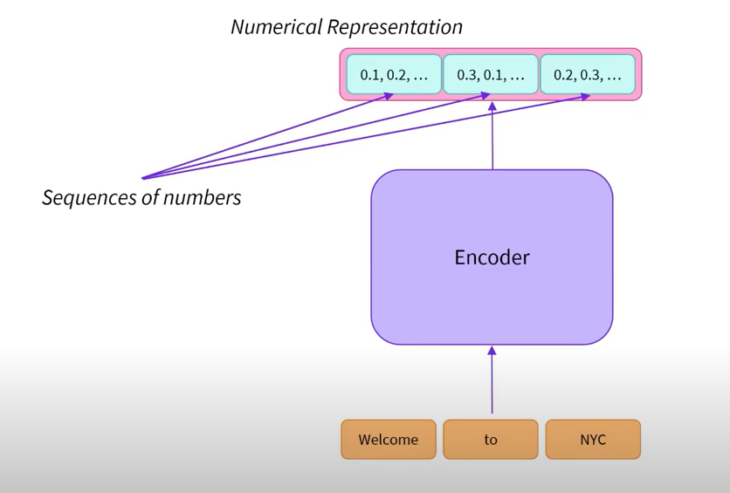
Encoders
Encoder is a digital circuit producing a binary output code depending on which of its inputs are activated.

Slide 4
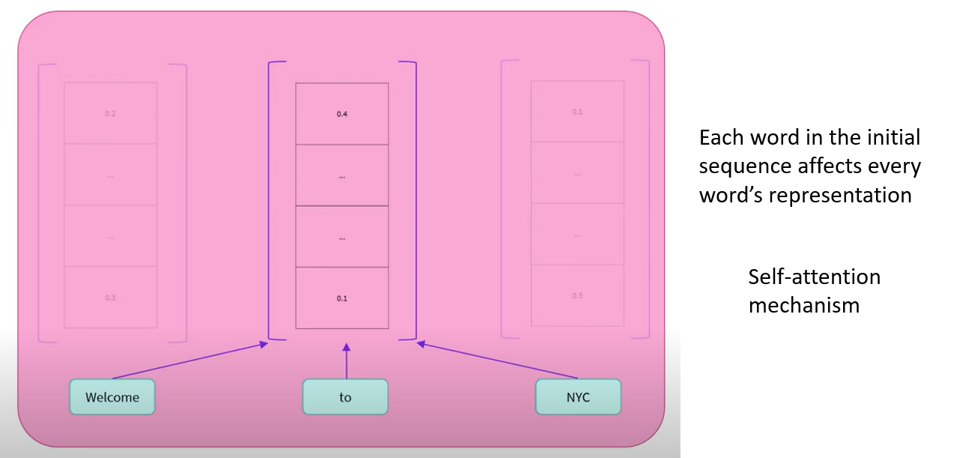
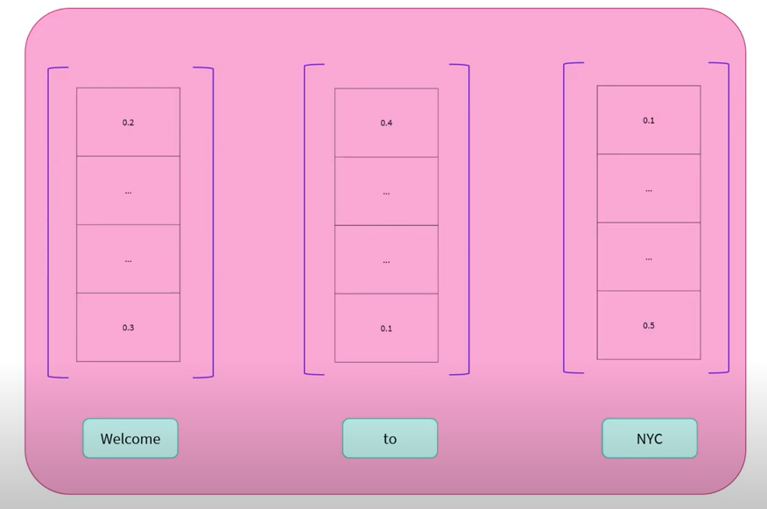
Encoders

Slide 5
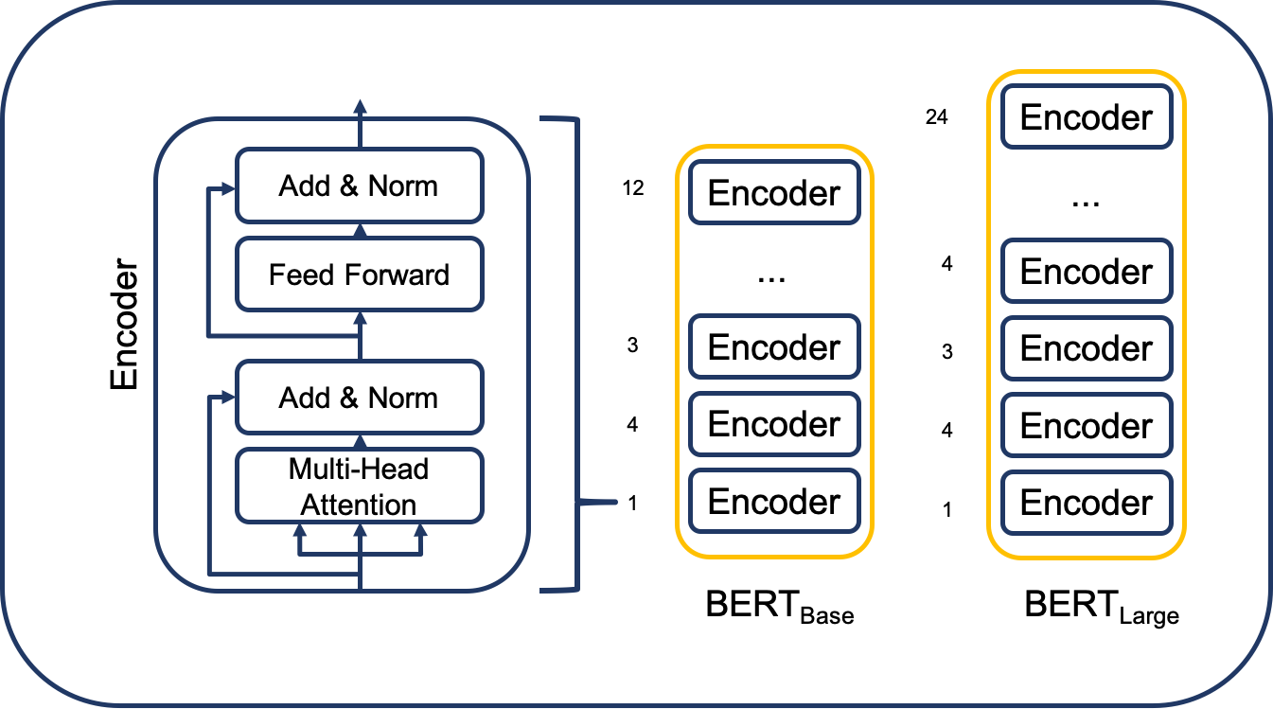
Why to use encoders?
Bi-directional: context from left and from right
Good at extracting meaningful information
Sequence classification

Slide 6
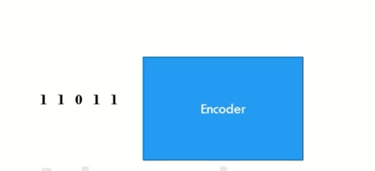
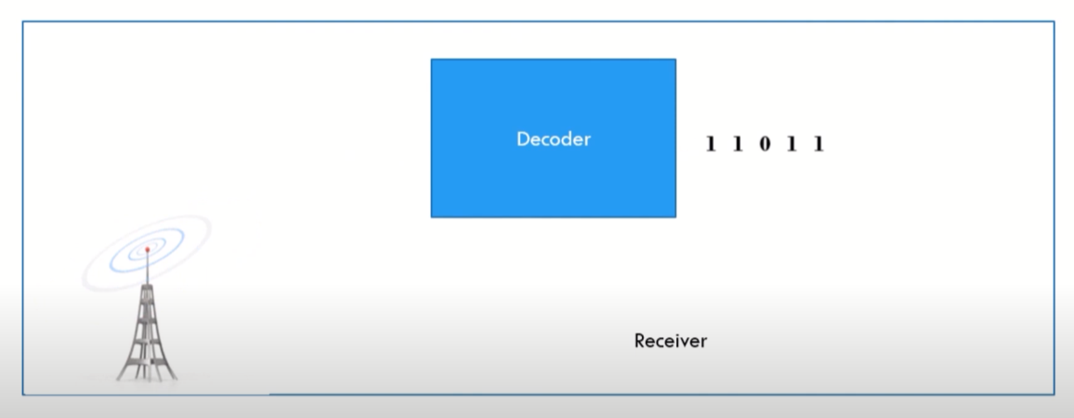
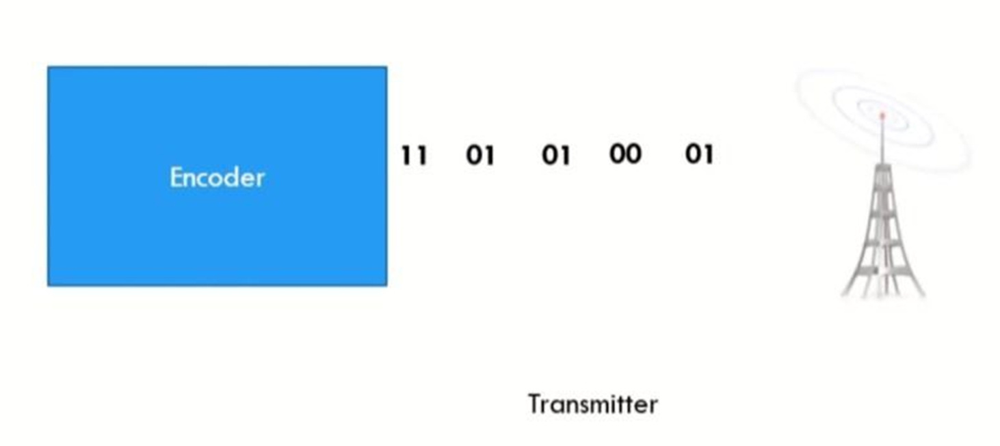
Data Transmission & Reception
Decoder is a digital circuit converting an input binary code into a single numeric output.

Slide 7
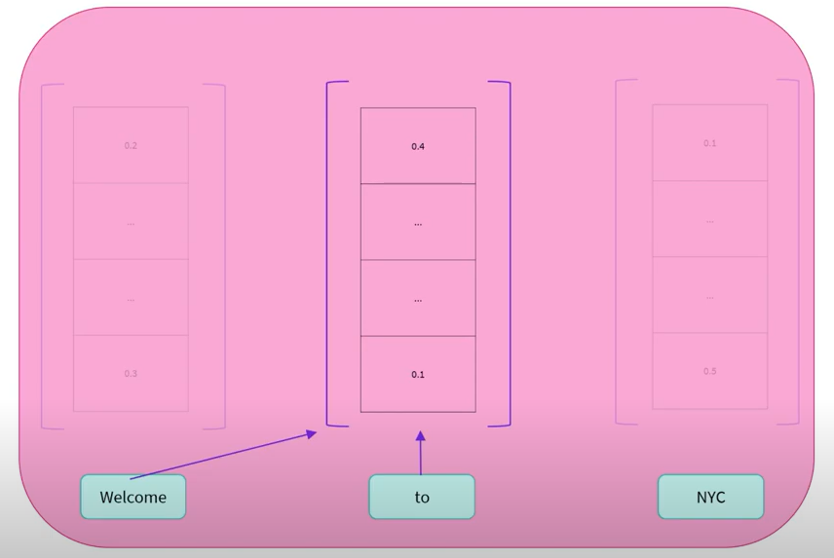
Decoders
Words can only see the words on their left side; the right side is hidden!
Masked self-attention mechanism

Slide 8

When to use decoders?
Unidirectional: access to their left (or right!) context
For GSM communication

Slide 9
ENCODER TRUTH TABLE
Input bit m0 | m1 | m2 | m3 | Output1 u1 | Output2 u2 | Encoder bit
1 | 0 | 0 | 0 | 1 | 1 | 000 - a
0 | 1 | 0 | 0 | 1 | 1 | 100 – b
1 | 0 | 1 | 0 | 0 | 1 | 010 – c
1 | 1 | 0 | 1 | 1 | 1 | 101 – d
0 | 1 | 1 | 0 | 0 | 1 | 110 – e
0 | 0 | 1 | 1 | 0 | 1 | 011 – f
0 | 0 | 0 | 1 | 1 | 1 | 001 - g

Slide 10
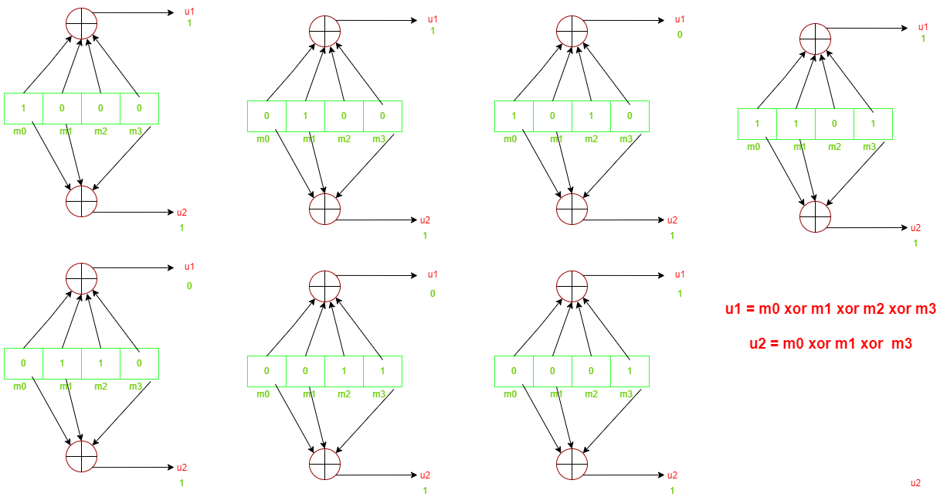
ENCODER DESIGN

Slide 11
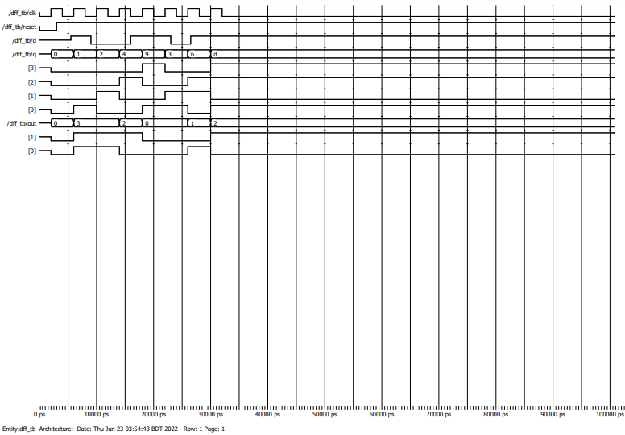
ENCODER WAVEFORM SIMULATION

Slide 12
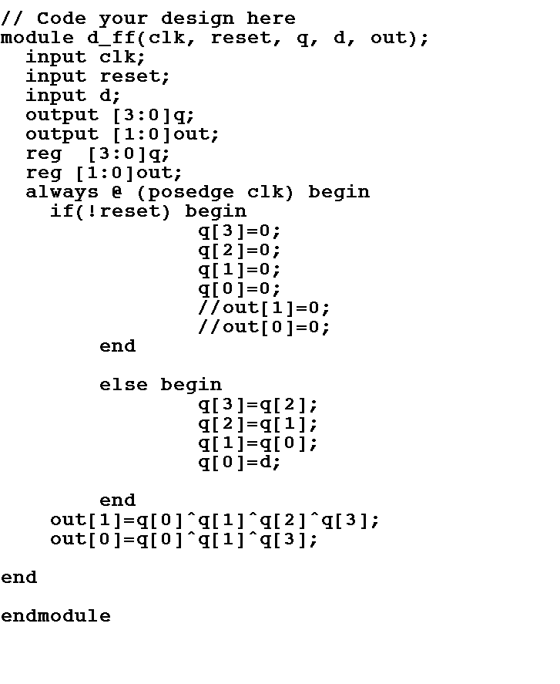
ENCODER IMPLEMENTATION

Slide 13
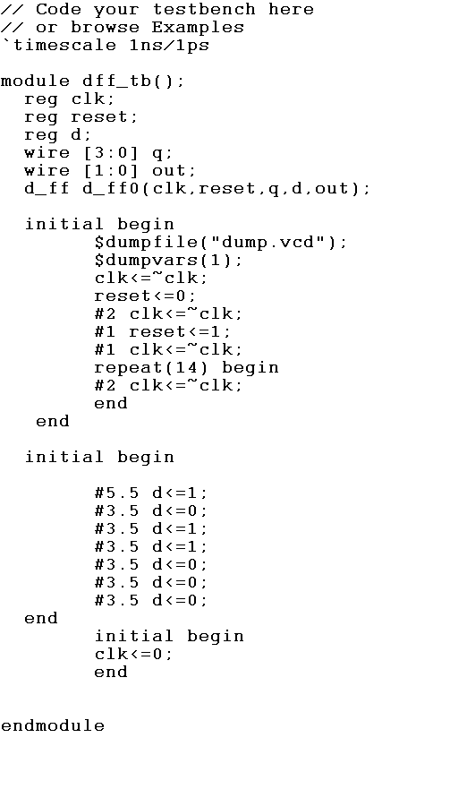
ENCODER IMPLEMENTATION – test bench

Slide 14
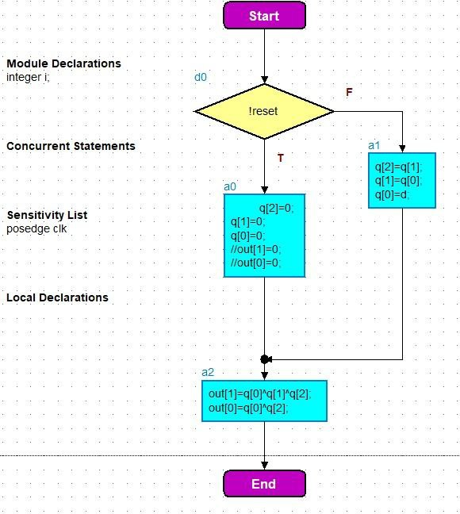
ENCODER FLOWCHART

Slide 15
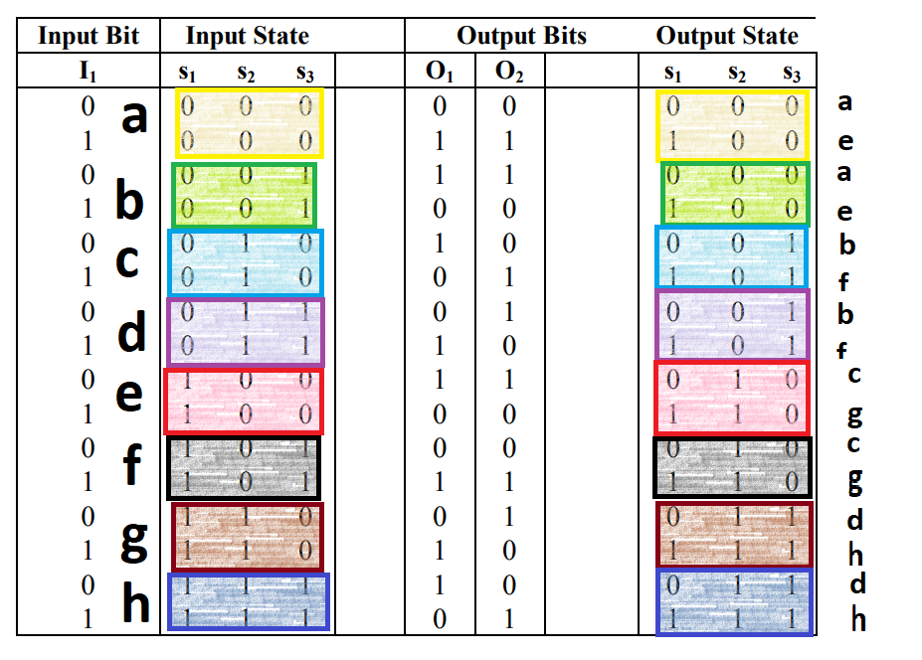
VITREBI DECODER (truth table)

Slide 16
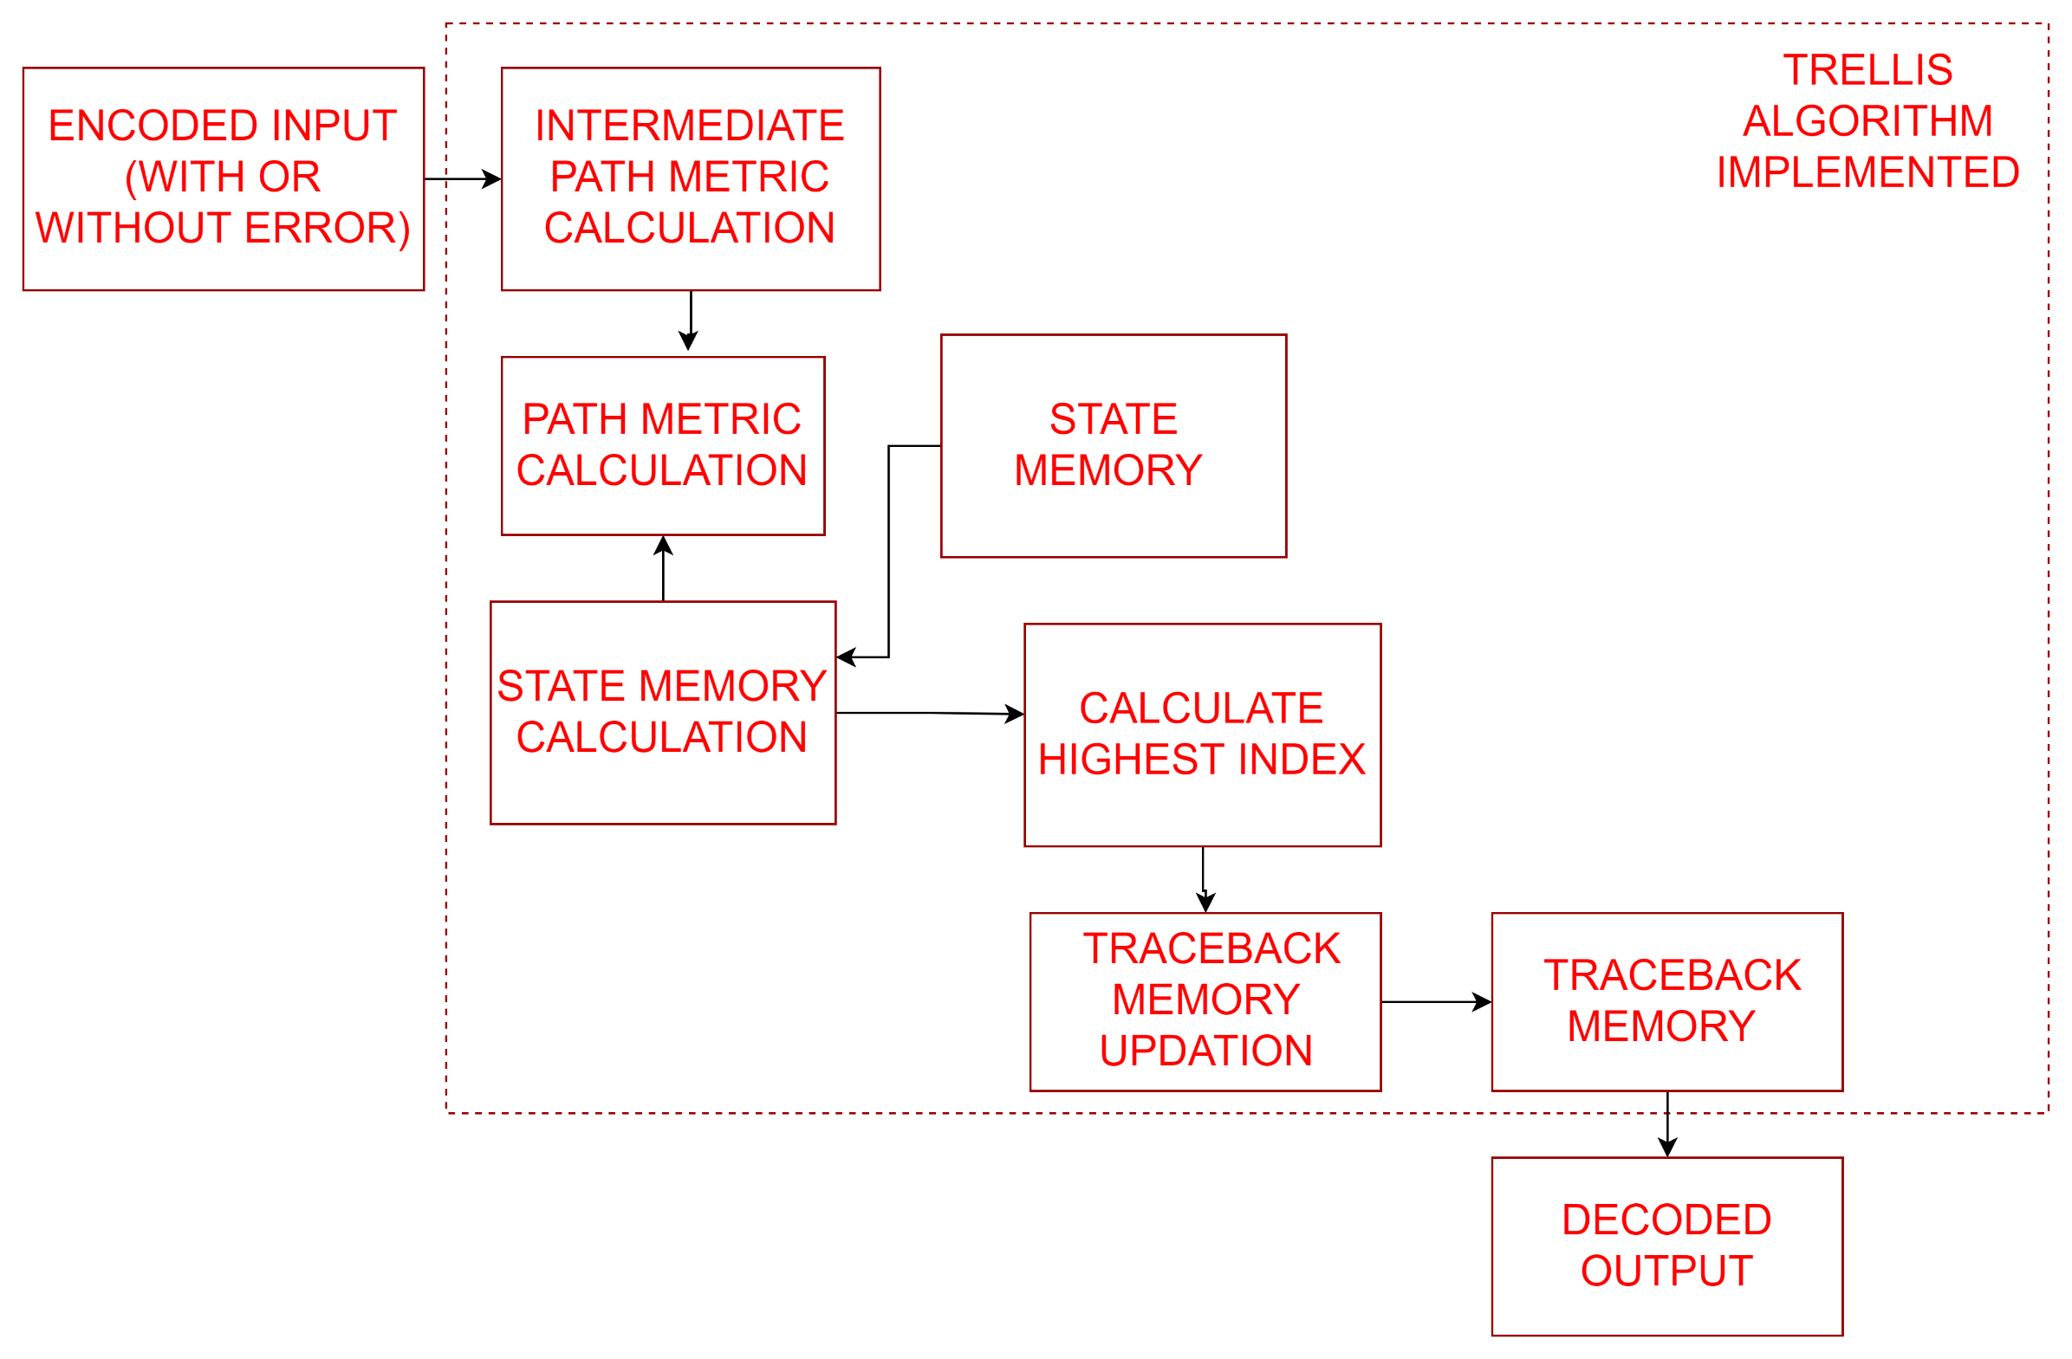
VITREBI DECODER (FUNCTIONAL DIAGRAM)

Slide 17
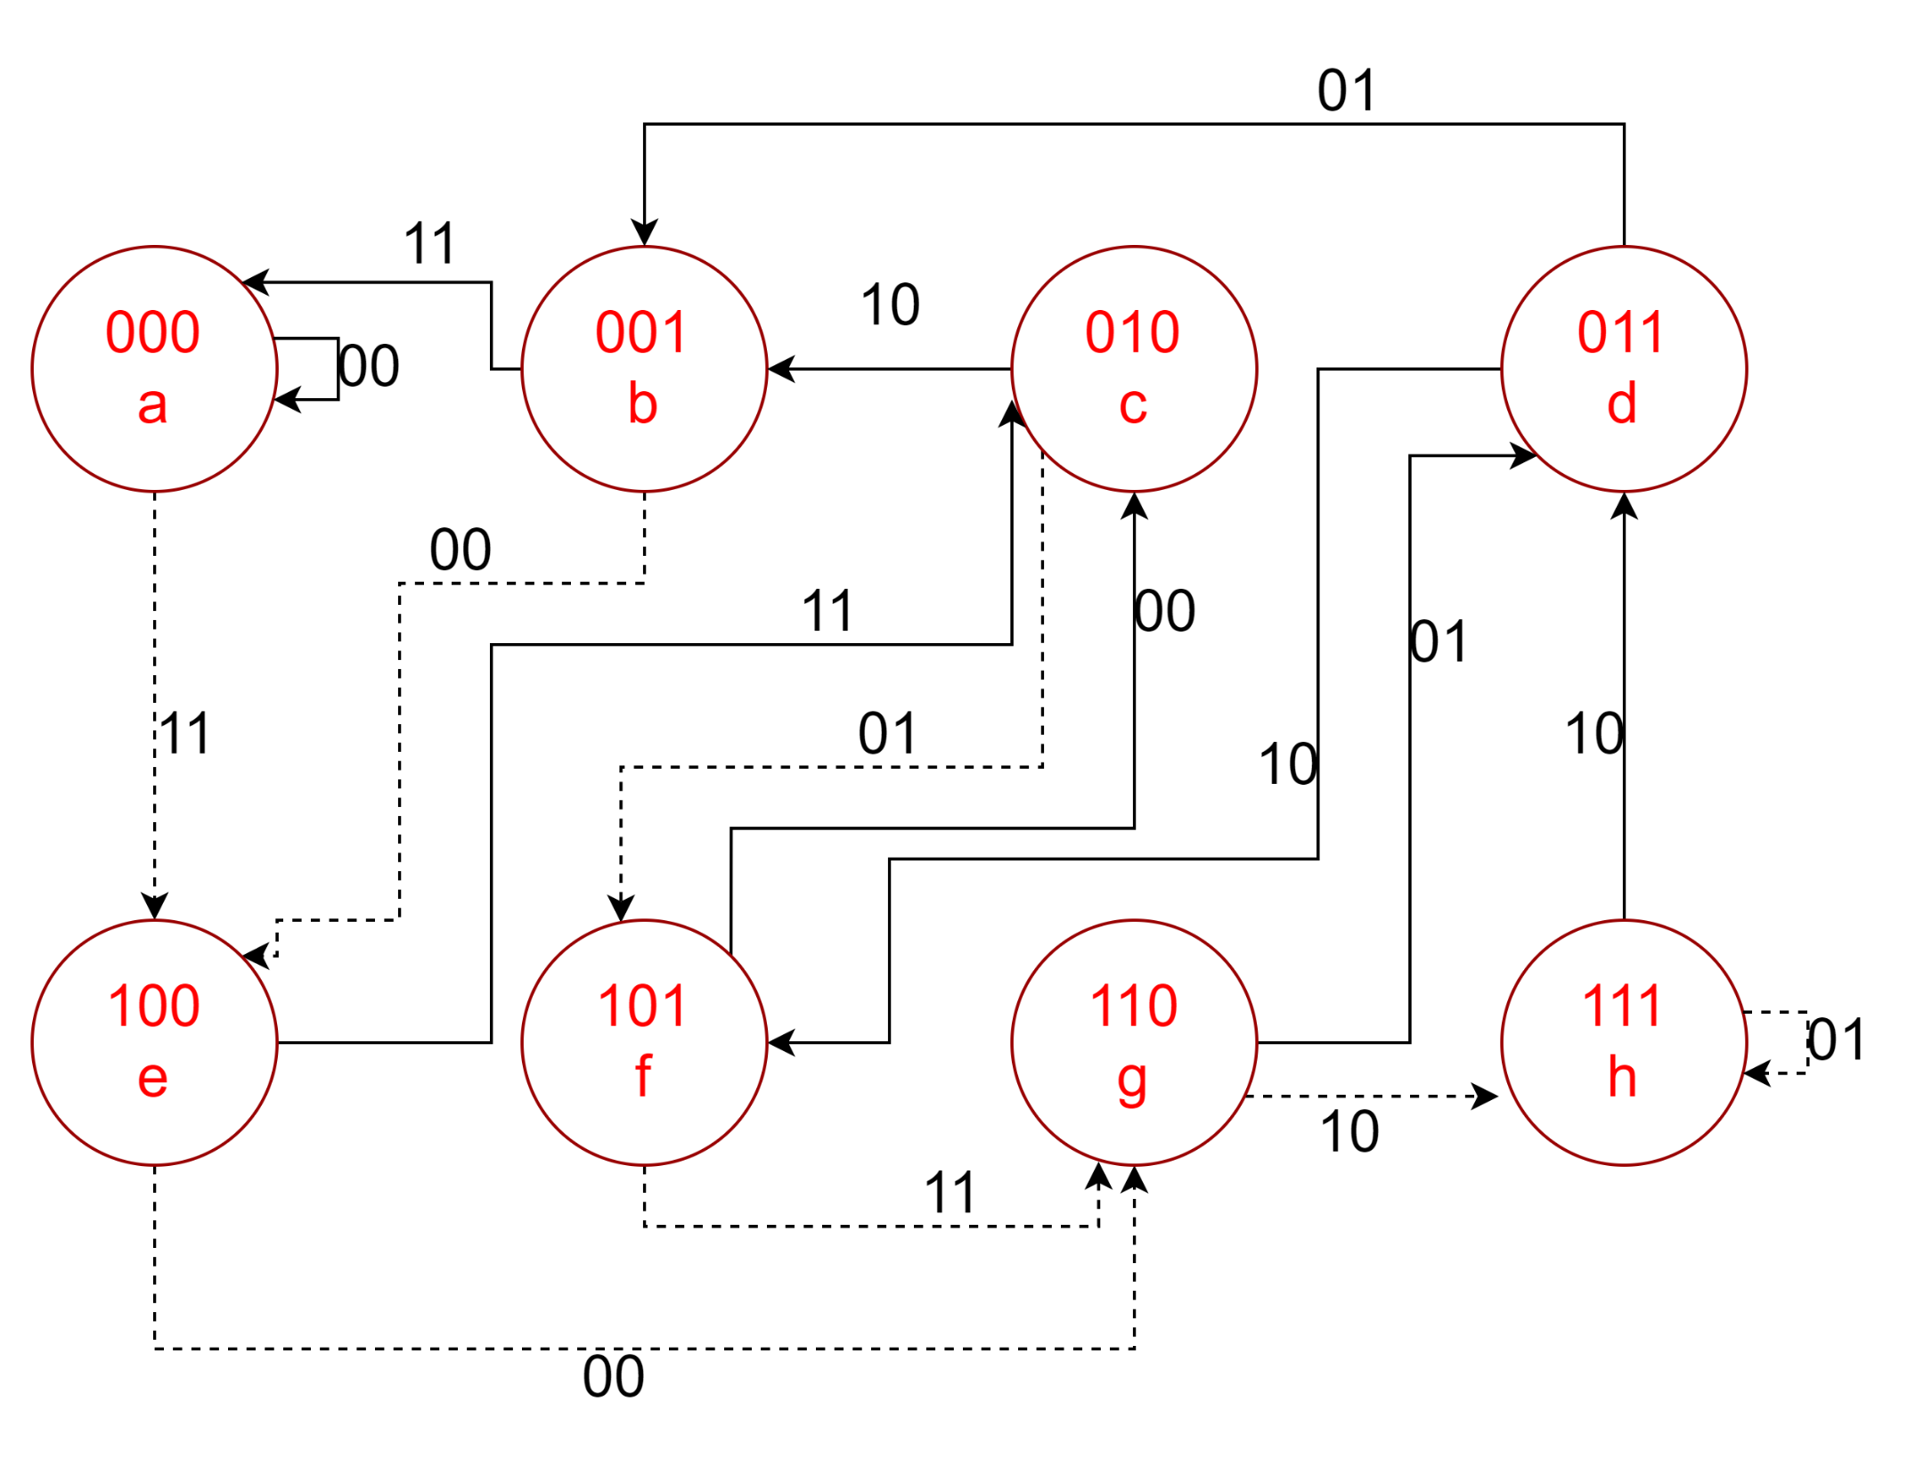
VITREBI DECODER (TASK GRAPH/state diagram)

Slide 18
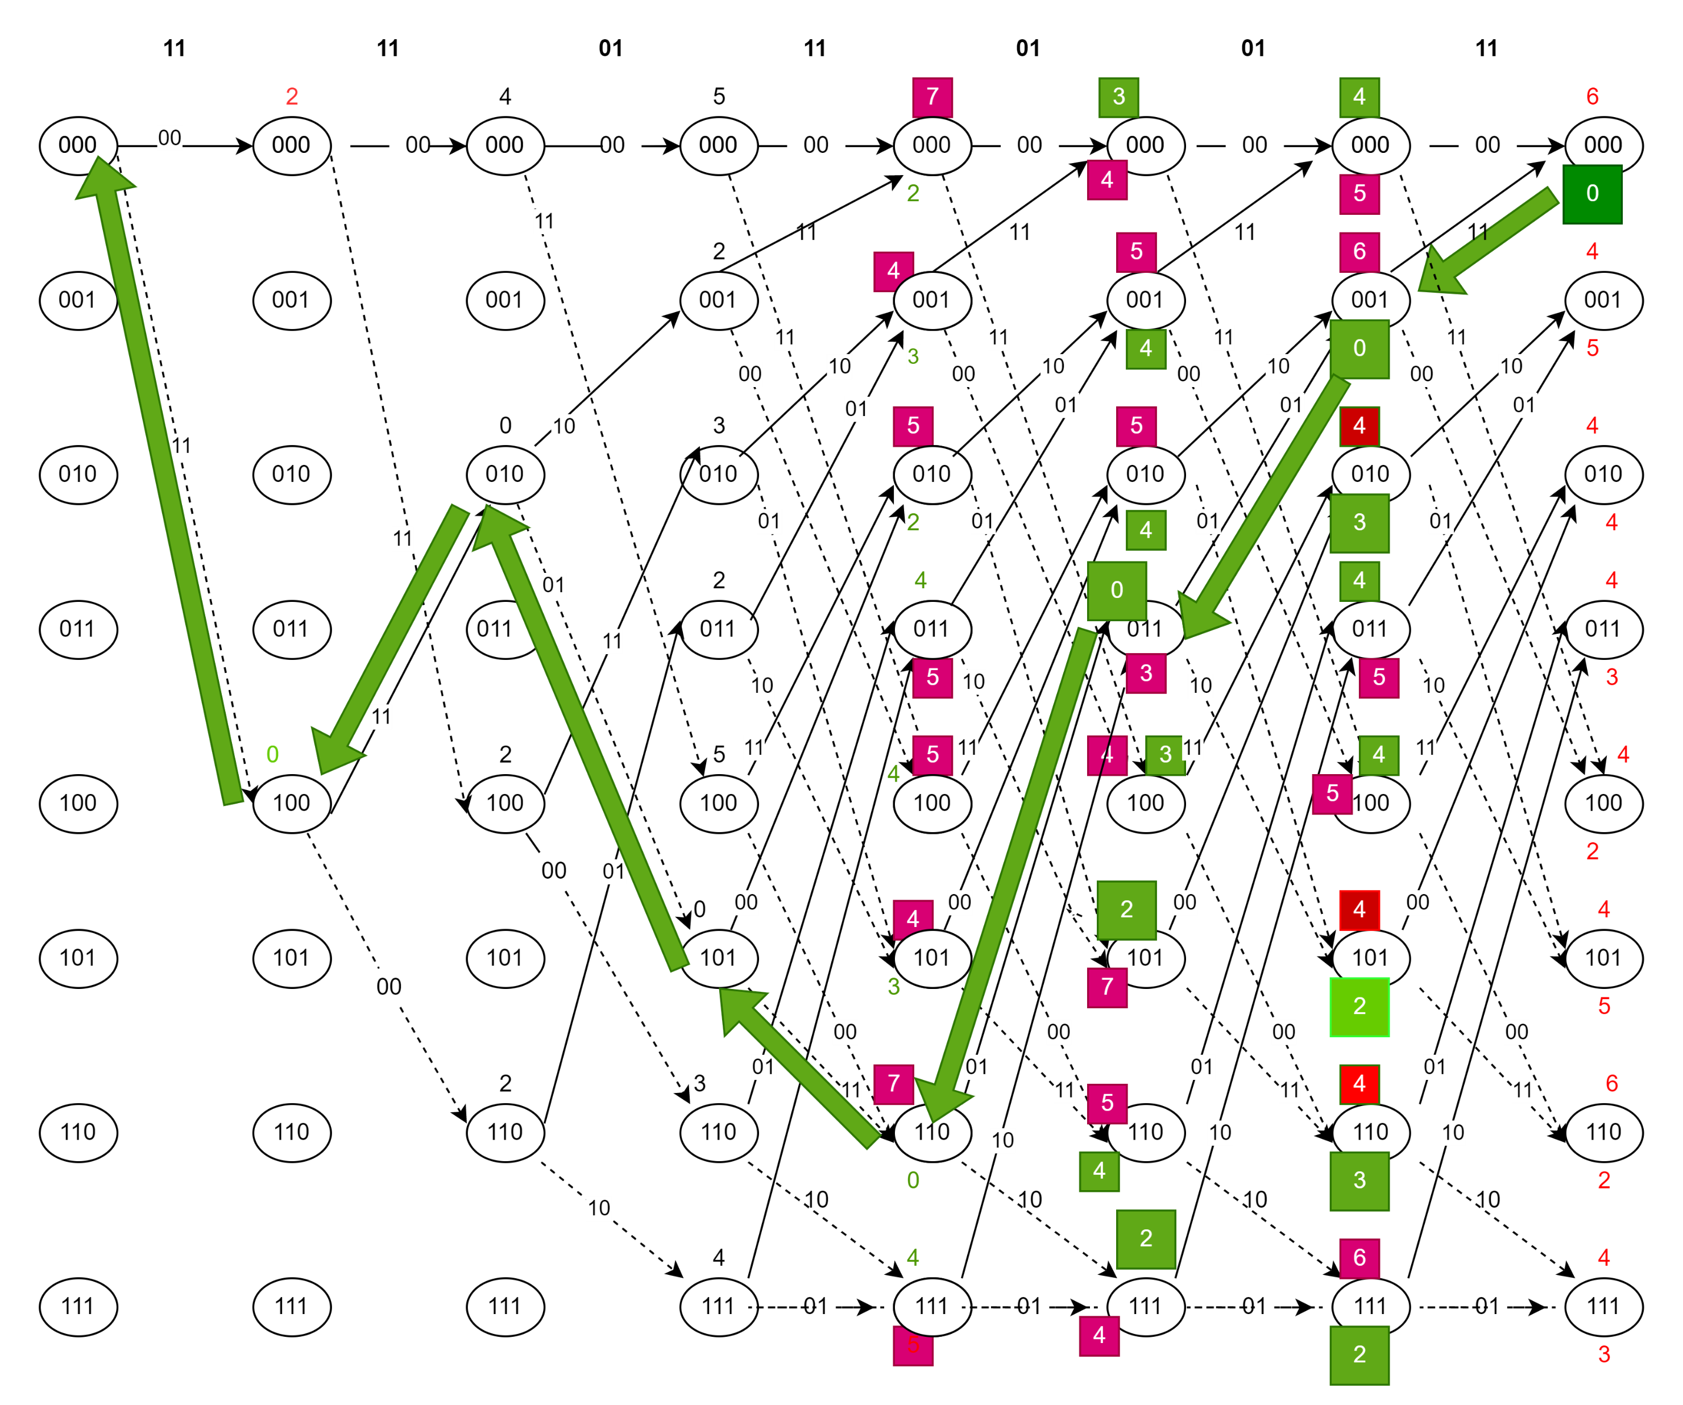
VITREBI DECODER (ALGORITHM/TRELLIS DIAGRAM)

Slide 19
Decoder Flow
On reset
Initialize all registers to 0
Step 1 Hamming Distance
Evaluate all the path metrics from input D
Step 2 Hamming Distance
Evaluate all the path metrics from input D and add with previous node
Step 3 Hamming Distance
Evaluate all the path metrics from input D
Step 4 Hamming Distance and path elimination
Evaluate all path metrics from D and eliminate other merging paths on the same node
Step 5 Hamming Distance and path elimination
Evaluate all path metrics from D and eliminate other merging paths on the same node
Step 6 Hamming Distance and path elimination
Evaluate all path metrics from D and eliminate other merging paths on the same node
Step 7 Hamming Distance and path elimination
Evaluate all path metrics from D and eliminate other merging paths on the same node

Slide 20
Flow cont.
Step 8
Step 8
Select lowest metric on final node
Step 9
Step 9
Trace back from selected node and decode received data from truth table
Step 10
Step 10
Set output pins

Slide 21
VITERBI DECODER testbench
module decoder_tb();
reg clk;
reg reset;
reg [13:0] dat;
wire [6:0] out;
reg ready;
decoder decoder_1(clk,reset,dat,out,ready);
initial begin
$dumpfile("dump.vcd");
$dumpvars(1);
clk<=~clk;
reset<=0;
#2 clk<=~clk;
#1 reset<=1;
#1 clk<=~clk;
repeat(100) begin
#2 clk<=~clk;
end
ready<=1;
#2 clk<=~clk;
repeat(40) begin
#2 clk<=~clk;
end
end
initial begin
clk<=0;
ready<=0;
dat[13]<=1;
dat[12]<=1;
dat[11]<=1;
dat[10]<=1;
dat[9] <= 0;
dat[8] <= 1;
dat[7] <= 1;
//dat[6] <= 1;
dat[6] <=0; //error
dat[5] <= 0;
dat[4] <= 1;
dat[3] <= 0;
dat[2] <= 1;
dat[1] <= 1;
dat[0] <= 1;
end
endmodule

Slide 22
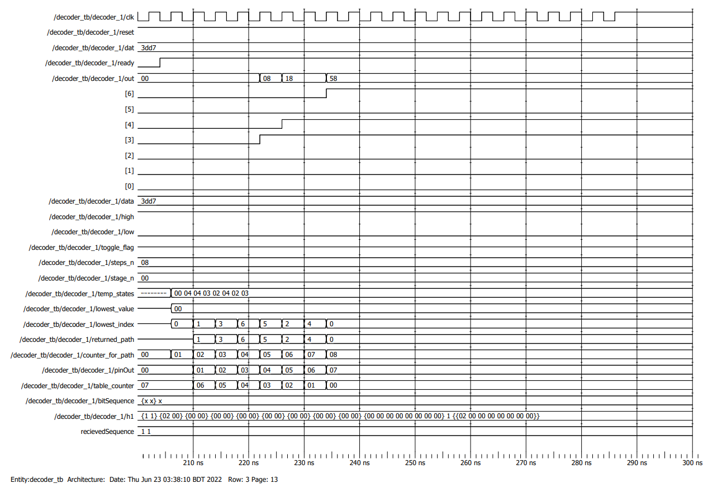

Slide 23
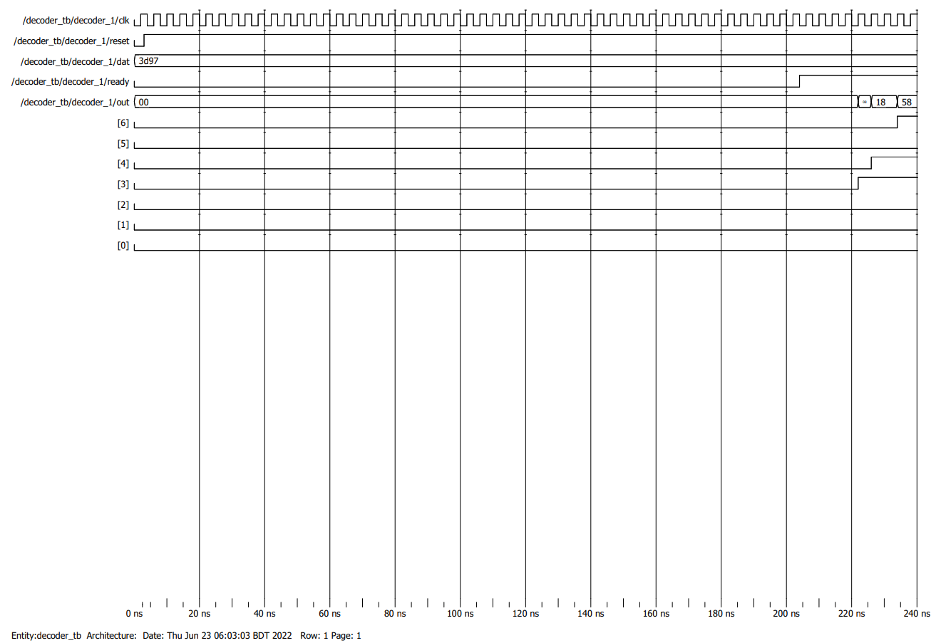
Proof of Correction and decoding
INPUT encoded frame
dat[13]<=1;
dat[12]<=1;
dat[11]<=1;
dat[10]<=1;
dat[9] <= 0;
dat[8] <= 1;
dat[7] <= 1;
//dat[6] <= 1;
dat[6] <=0; //error
dat[5] <= 0;
dat[4] <= 1;
dat[3] <= 0;
dat[2] <= 1;
dat[1] <= 1;
dat[0] <= 1;

Slide 24
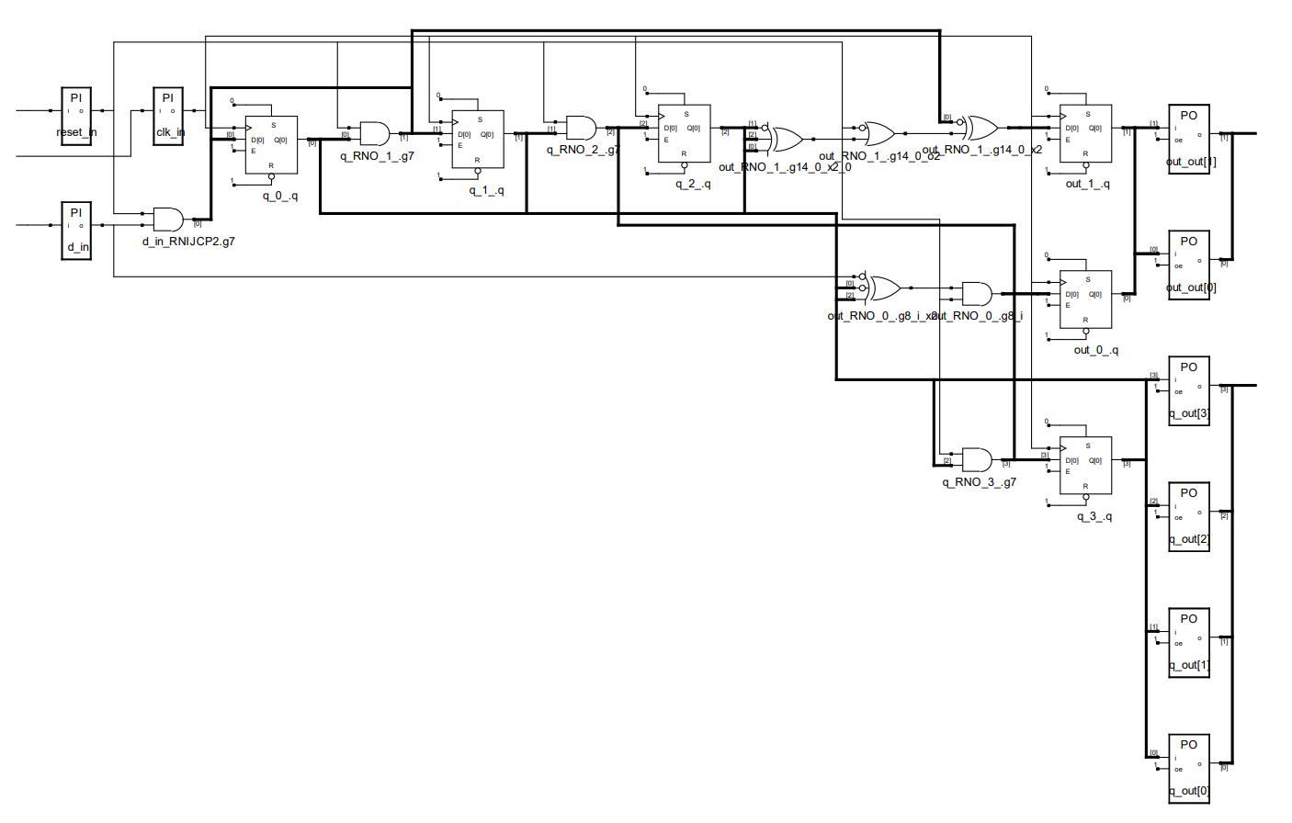
Encoder Synthesis

Slide 25

Decoder Synthesis

Slide 26
